Slide 1
Automating Logic Apps deployment with GitHub Actions
Mandar Dharmadhikari
Associate Manager – Business and Integration Architecture group > Accenture India
@fullstackmaddy

Slide 2


Yours truly,
Business and Integration Architecture Associate Manager at Accenture India
Integration and all things Blazor fan
Budding Pianist
Seasoned cook & foodie
fullstackmaddy
@fullstackmaddy
In/mandar-dharmadhikari

Slide 3
Agenda
The What and The Why of GITHUB Actions
Basic Concepts of GitHub Actions
Typical CICD workflow for Logic Apps(The How)
Questions

Slide 4
The What
GitHub Actions are the event driven workflows defined on GitHub repositories
Can be configured to trigger on one or multiple events that occur on a repository
Provide a simple way to automate many tasks right from CICD pipelines to release management and administration
Work with Pay as You Go structure (public repo get free execution)

Slide 5
The Why
Tight Integration with GitHub repositories
Easy to set up
Can be configured using simple yaml files
Plethora of inbuilt as well as community actions to automate tasks

Slide 6
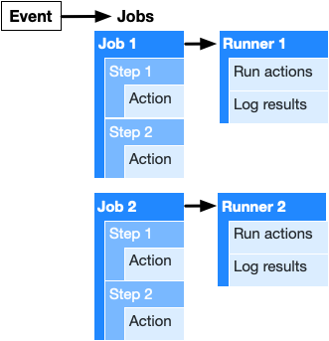
Anatomy of A GitHub Actions Workflow

Slide 7
101 on GITHUB Actions
Typical CI CD Flow

Slide 8
The How (Demo)

Slide 9
Reference Links
https://docs.github.com/en/actions
Demo Repository : https://github.com/fullstackmaddy/logicapps-arm-cicd

